Slide 1

SC209
Environmental Studies
Photosynthetically Active Radiation (PAR) and Climate Change

Slide 2
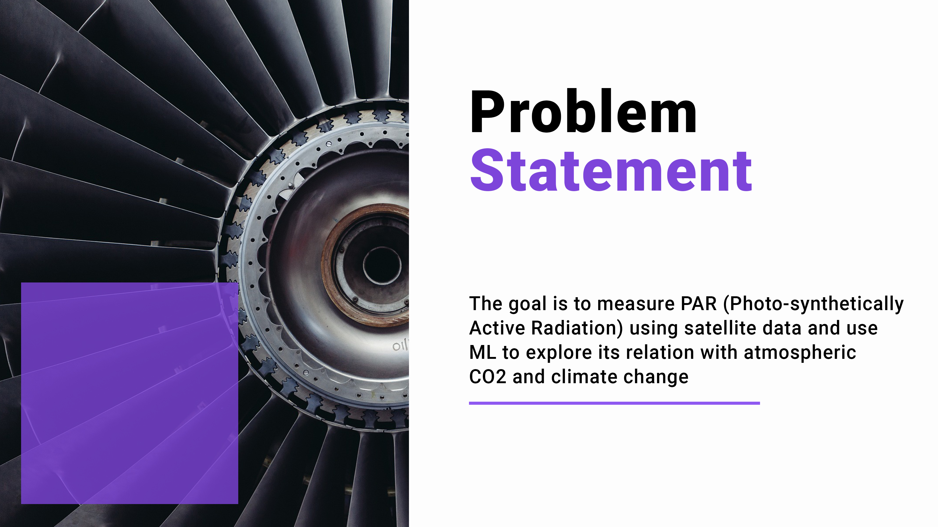

Slide 3
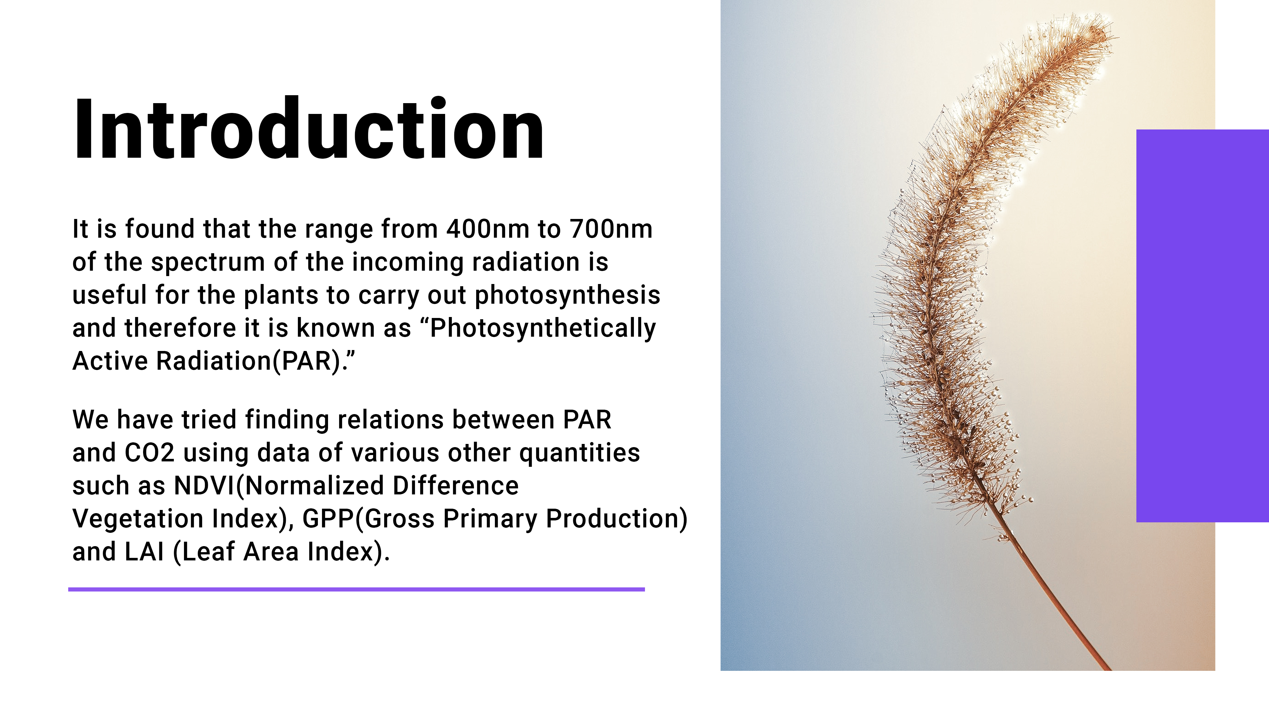

Slide 4
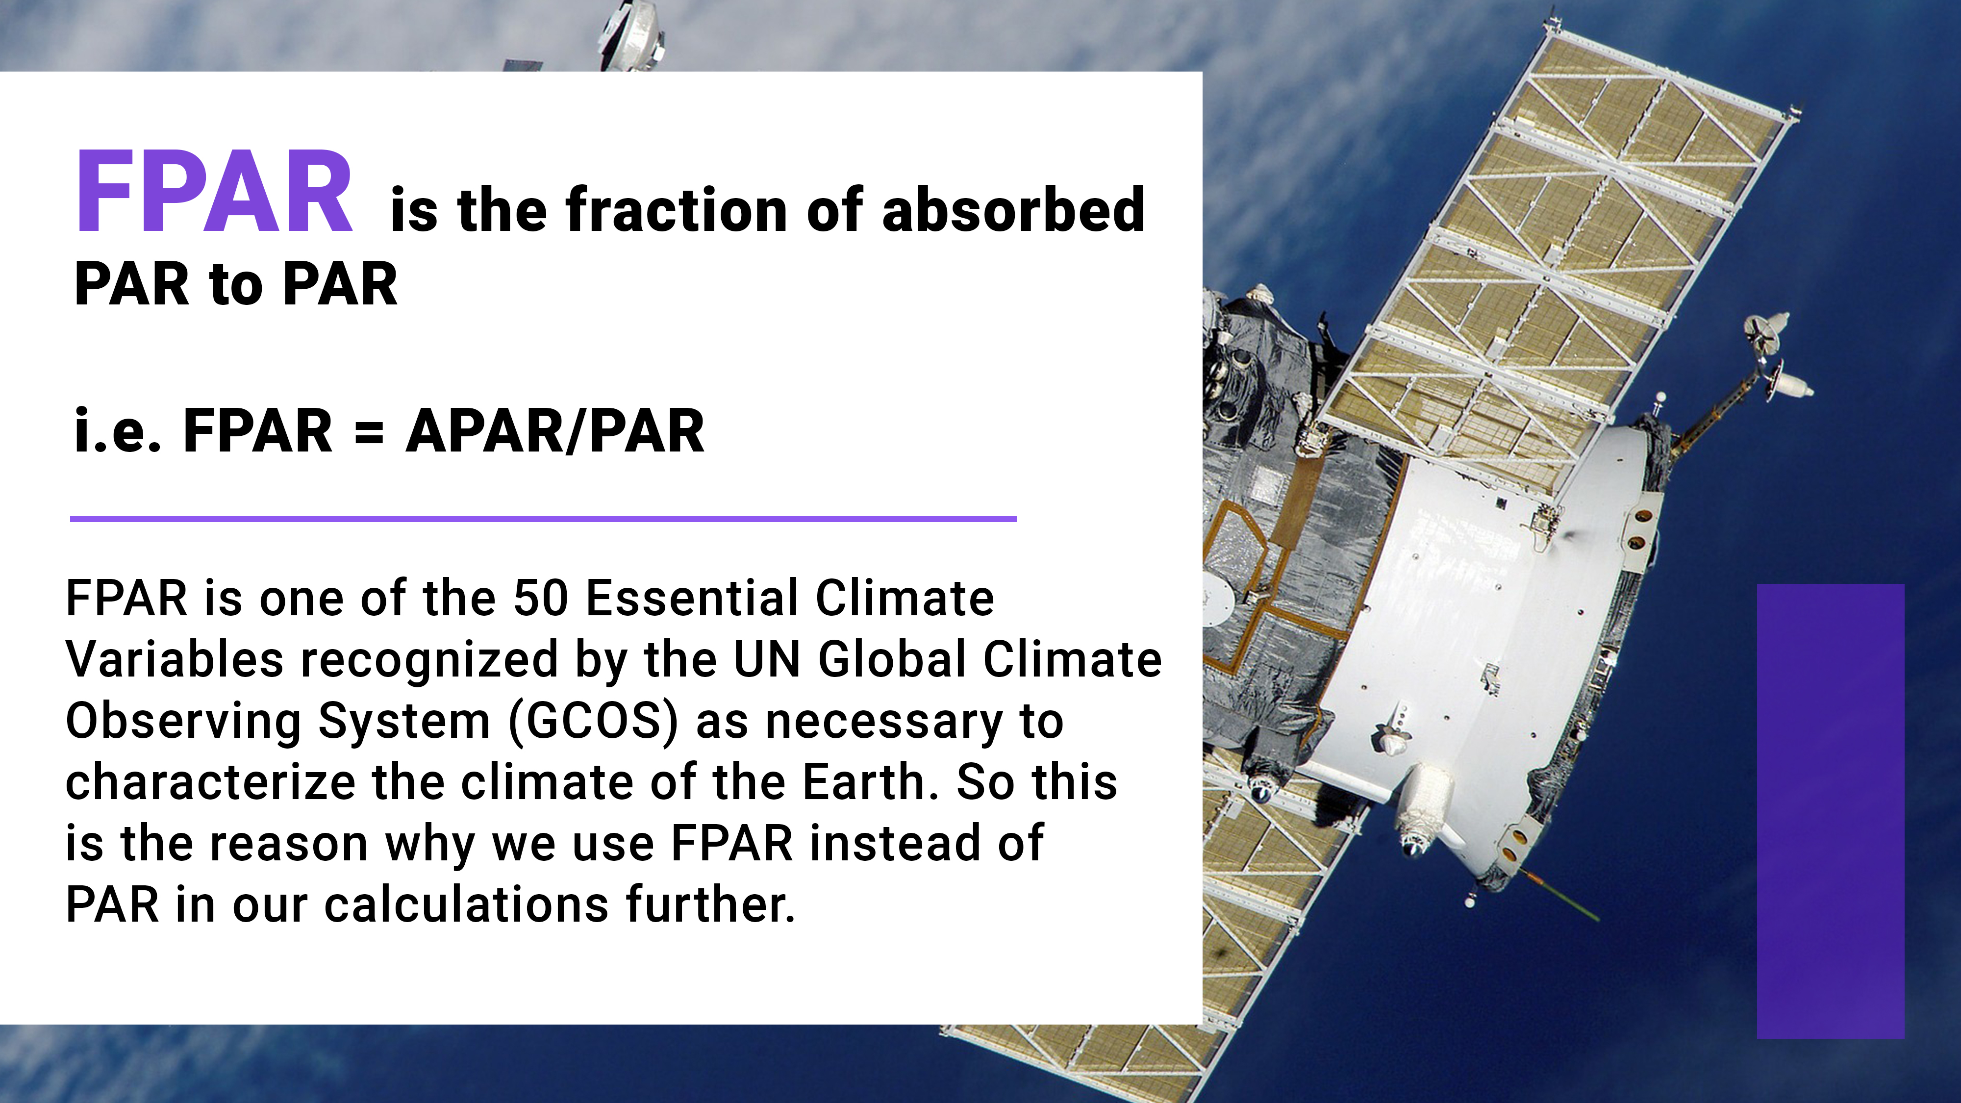

Slide 5
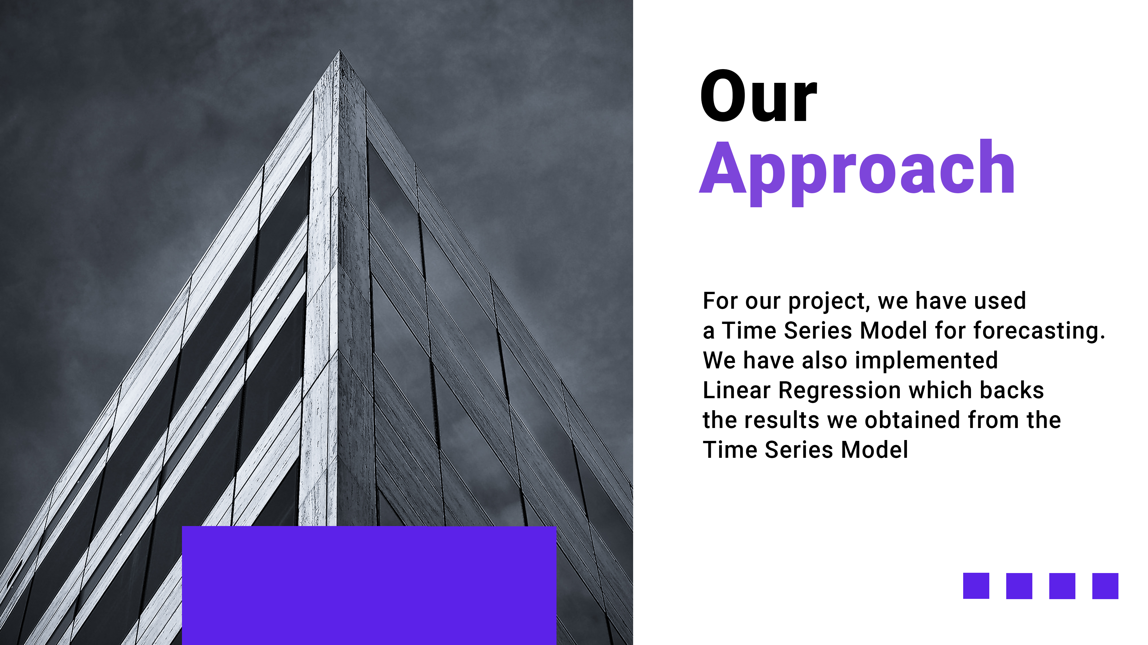

Slide 6
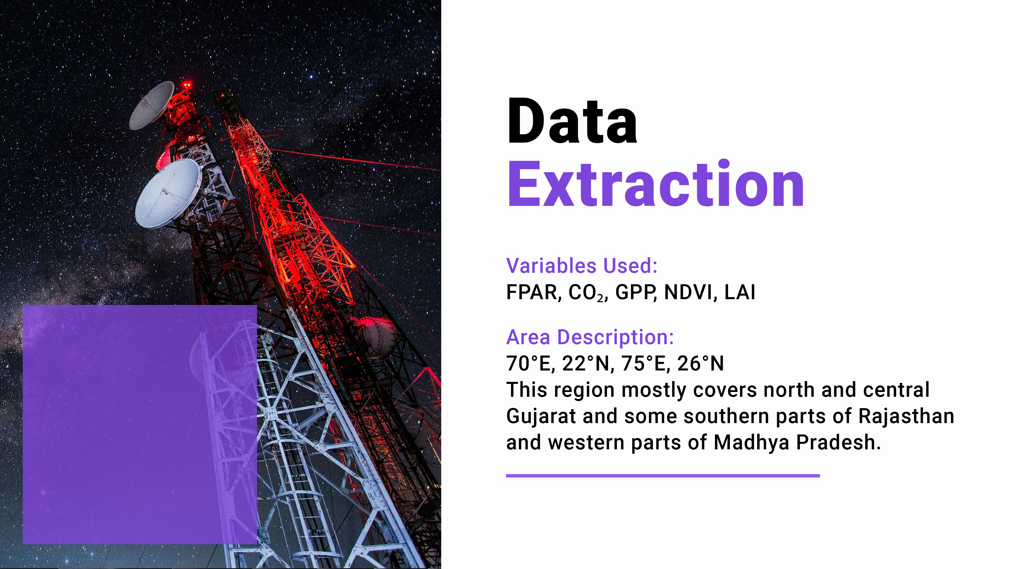

Slide 7


Slide 8
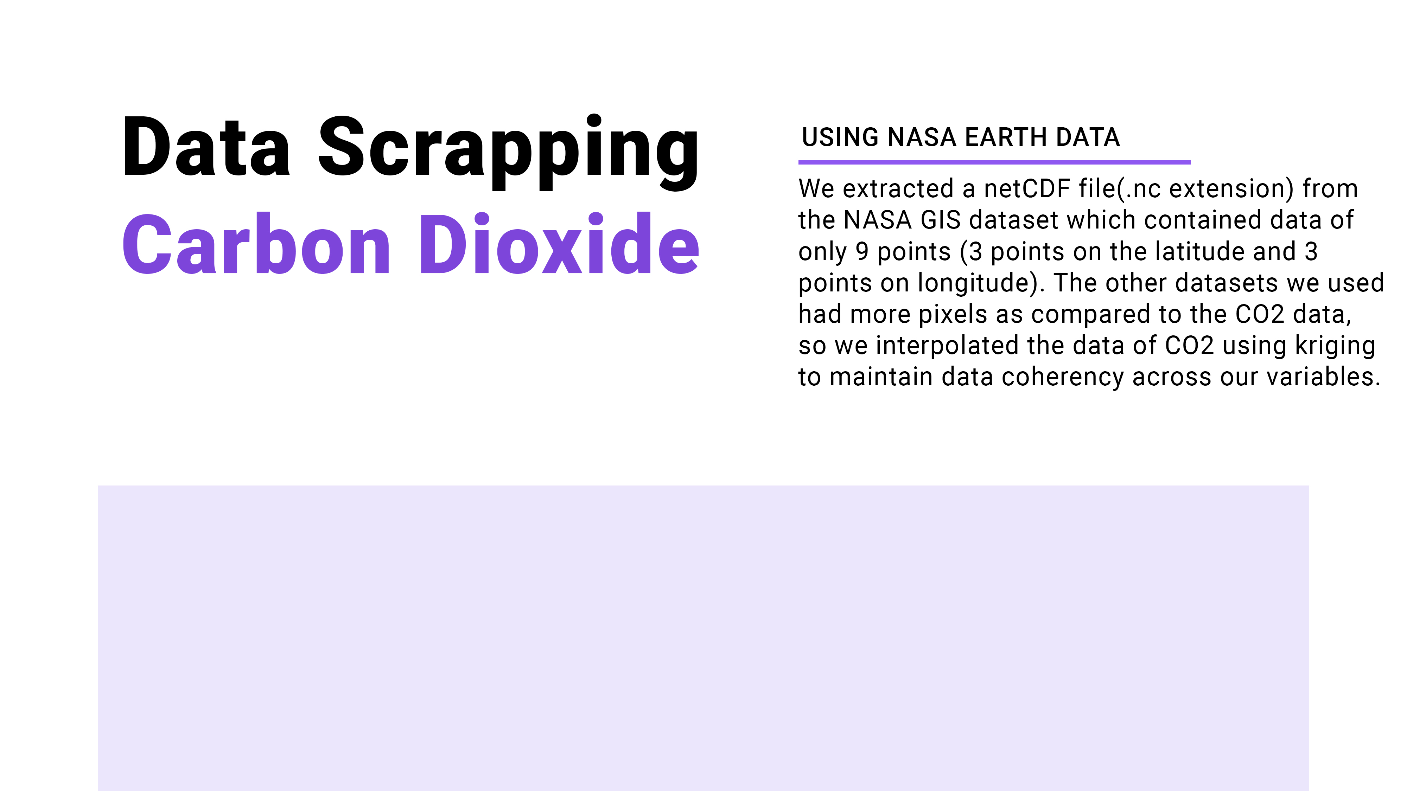

Slide 9
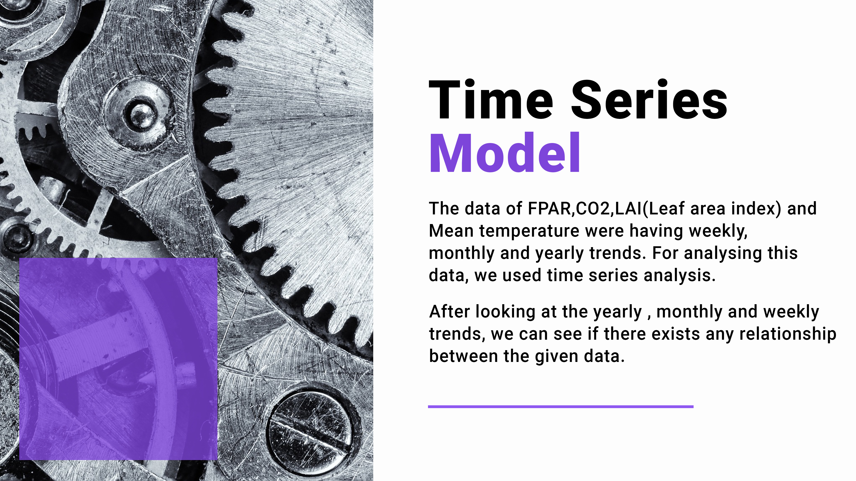

Slide 10


Slide 11
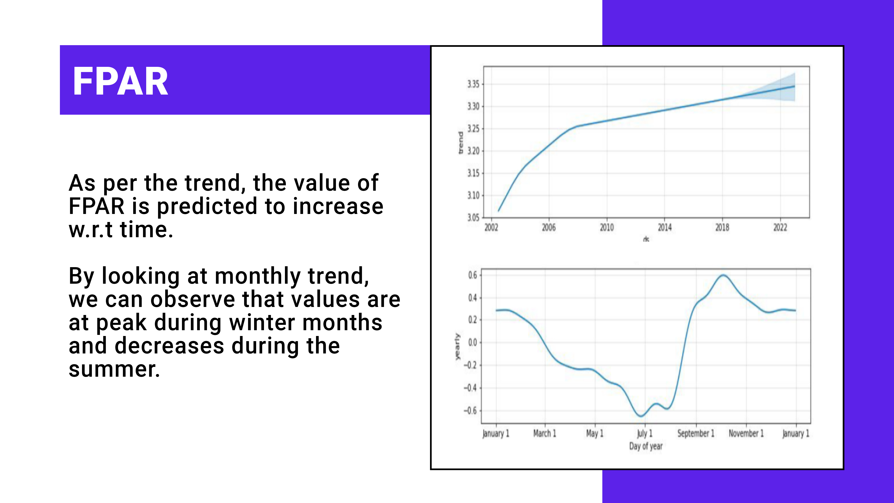

Slide 12
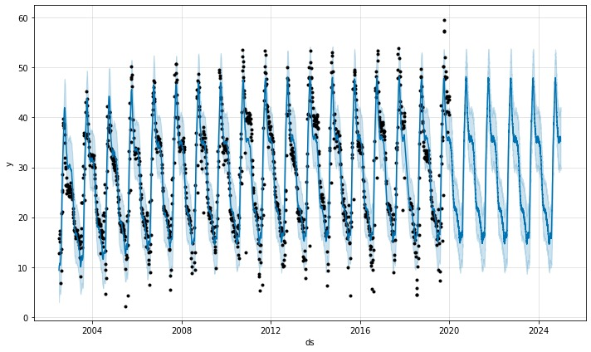
Future trend of FPAR

Slide 13
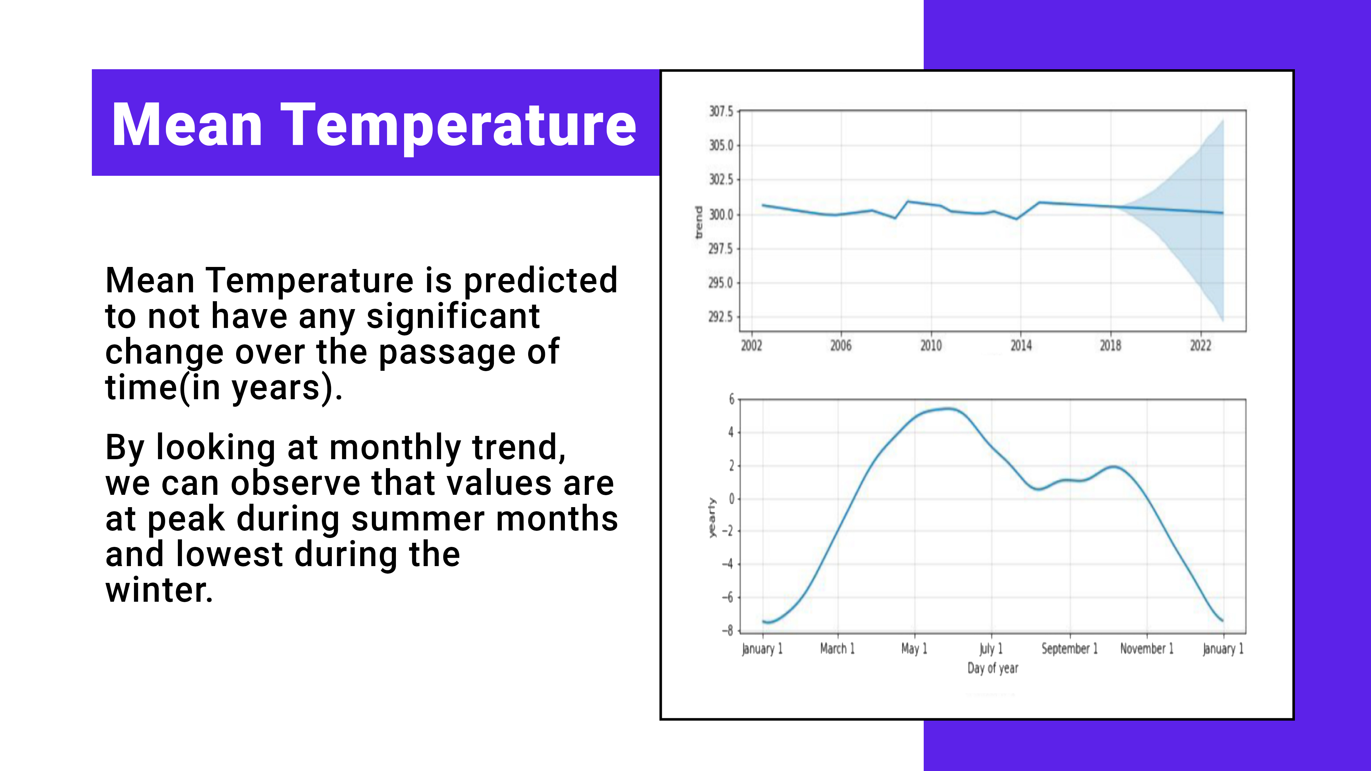

Slide 14
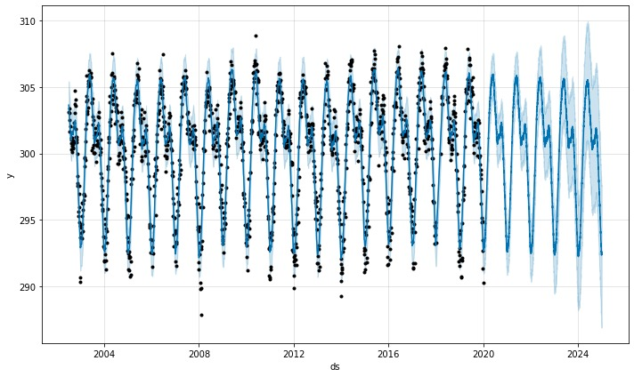
Future trend of Mean Temperature

Slide 15
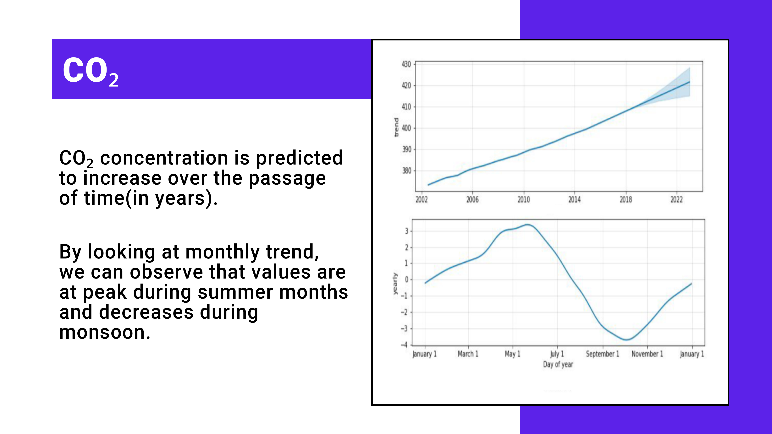

Slide 16
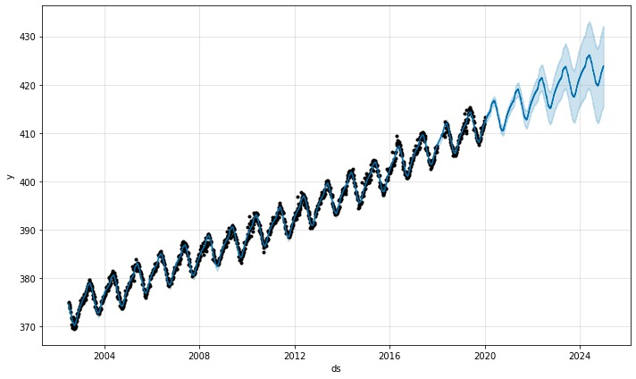
Future trend of CO₂

Slide 17
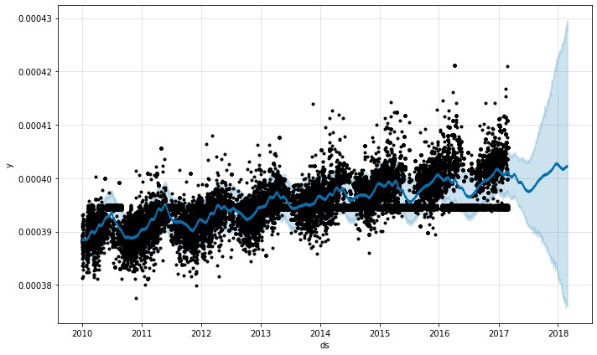
CO₂ analysis over Gujarat

Slide 18


Slide 19
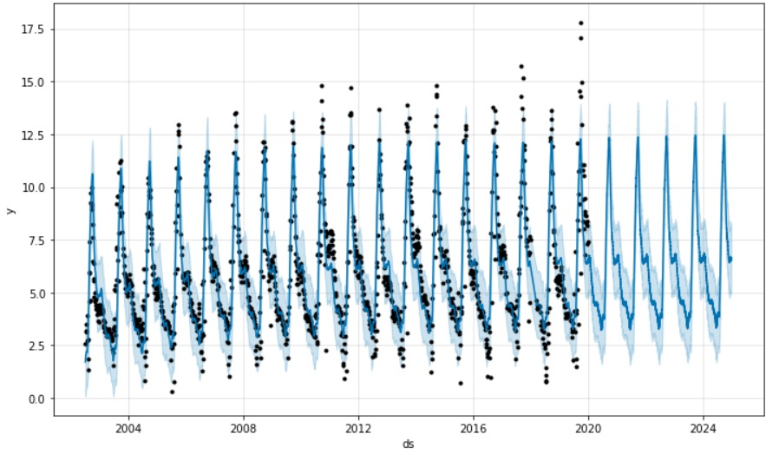
Future trend of LAI

Slide 20
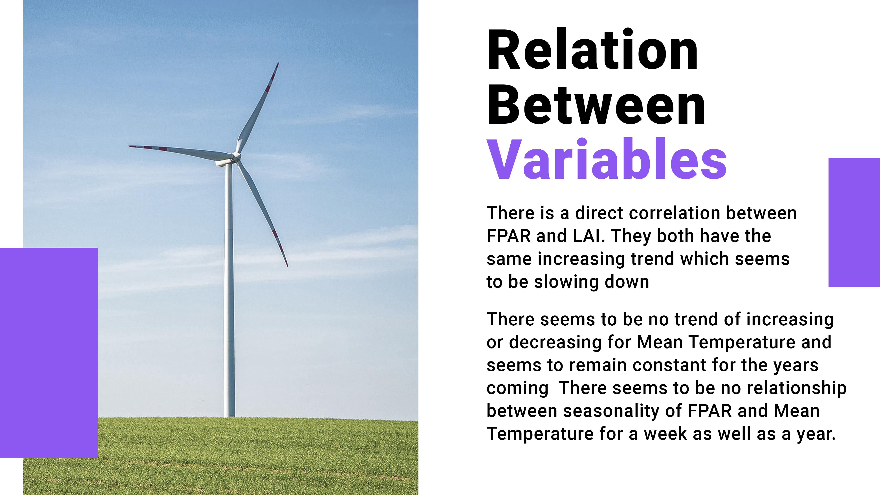

Slide 21
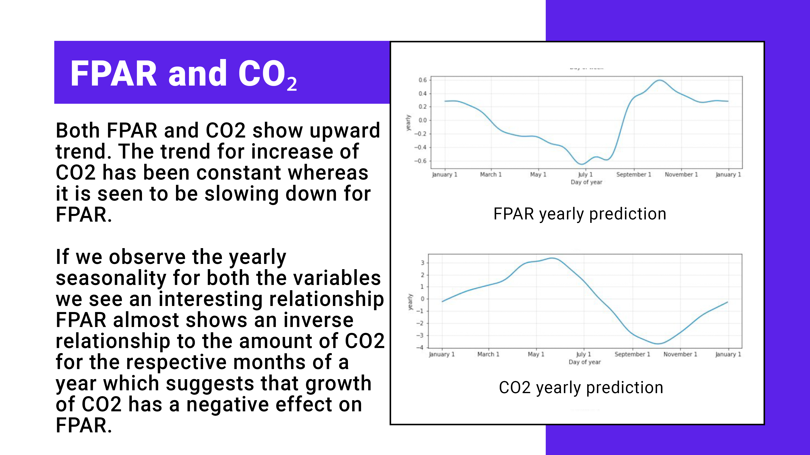

Slide 22
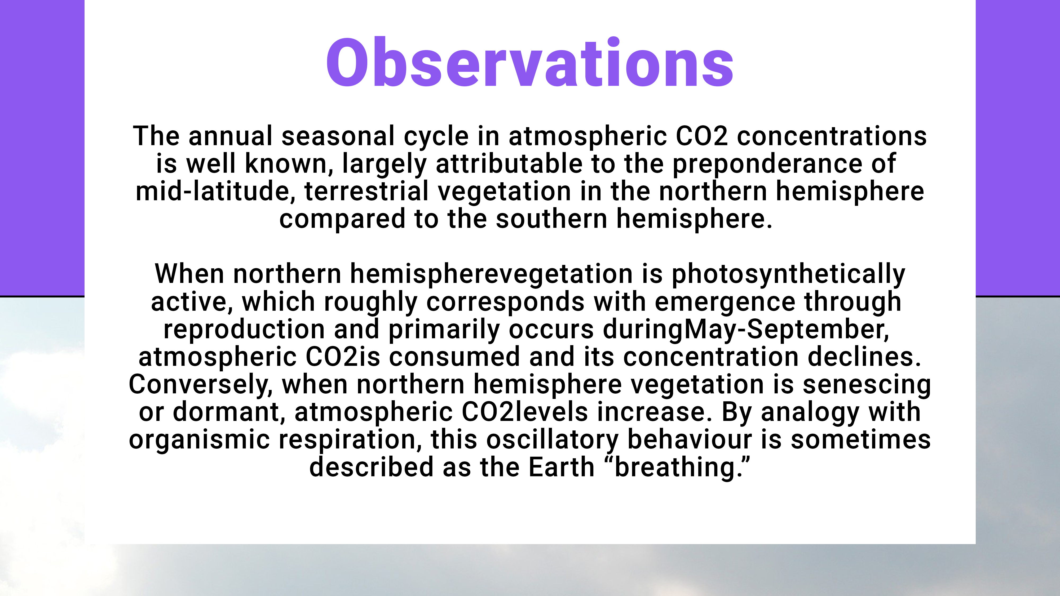
The annual seasonal cycle in atmospheric CO₂ concentrations is well known, largely attributable to the preponderance of mid-latitude, terrestrial vegetation in the northern hemisphere compared to the southern hemisphere.
When northern hemisphere vegetation is photosynthetically active, which roughly corresponds with emergence through reproduction and primarily occurs during May-September, atmospheric CO₂ is consumed and its concentration declines. Conversely, when northern hemisphere vegetation is senescing or dormant, atmospheric CO₂ levels increase. By analogy with organismic respiration, this oscillatory behavior is sometimes described as the Earth “breathing.”

Slide 23
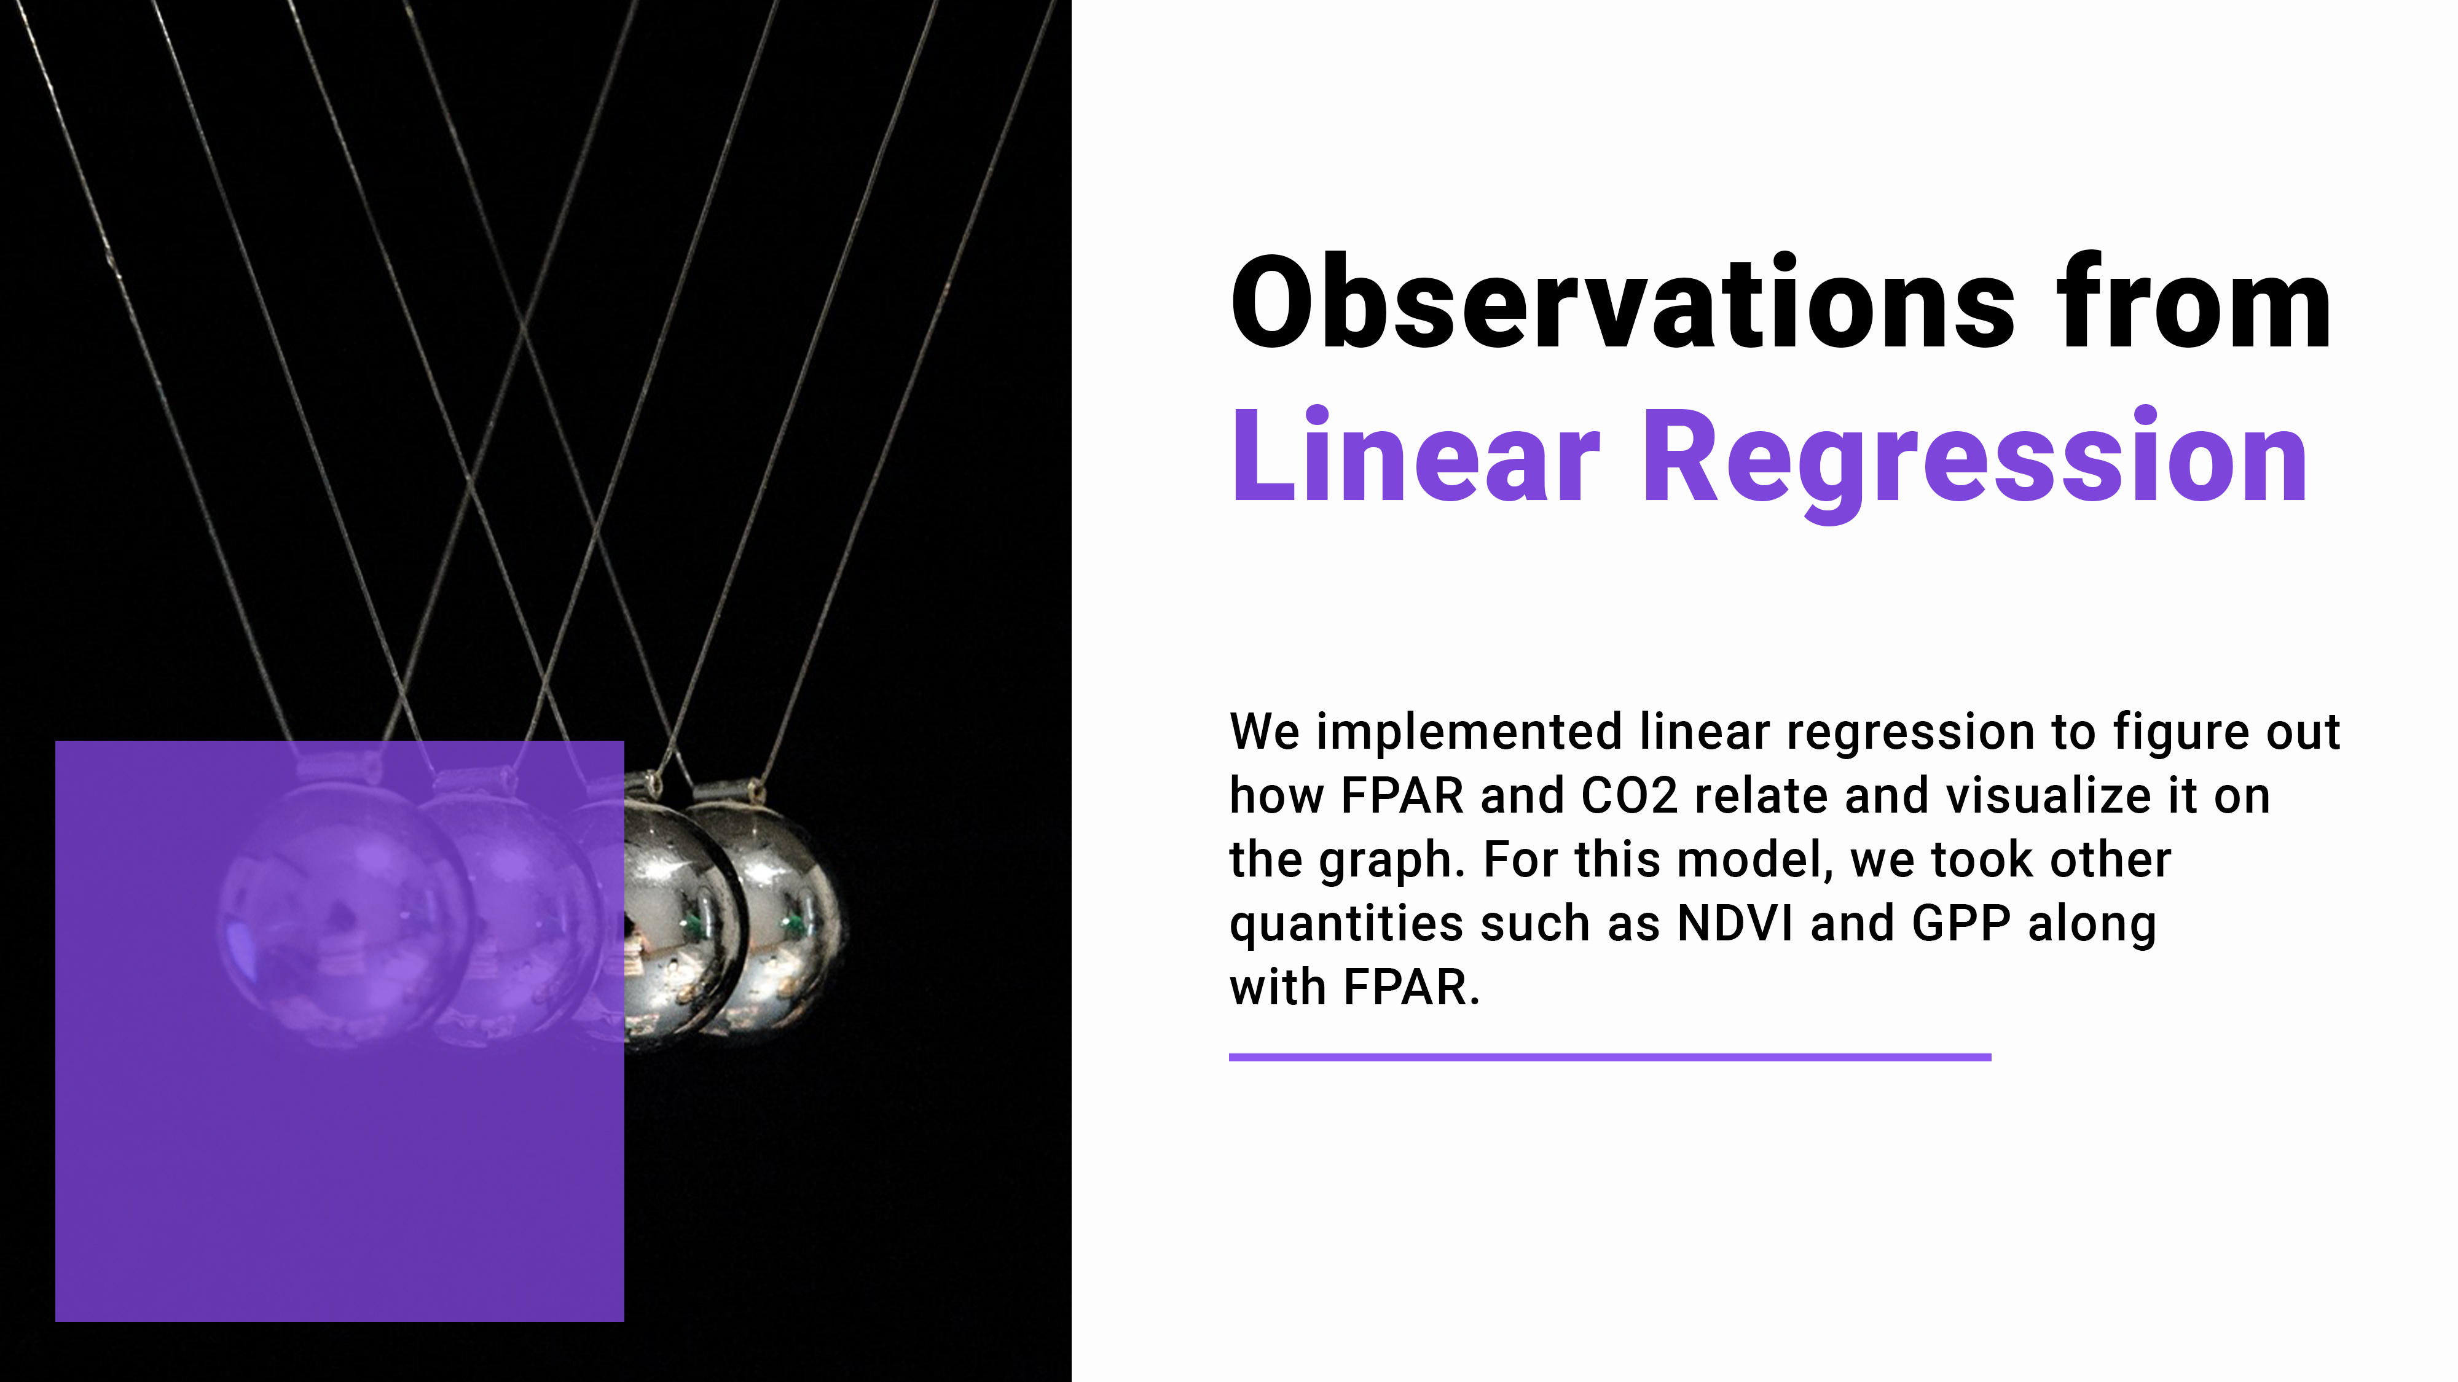

Slide 24
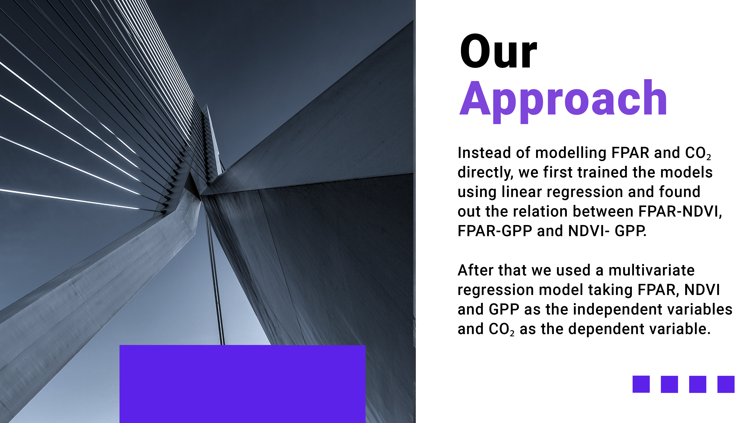

Slide 25
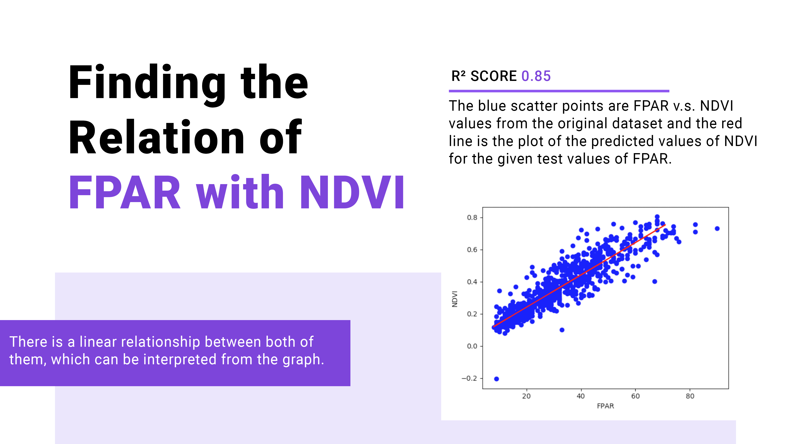

Slide 26
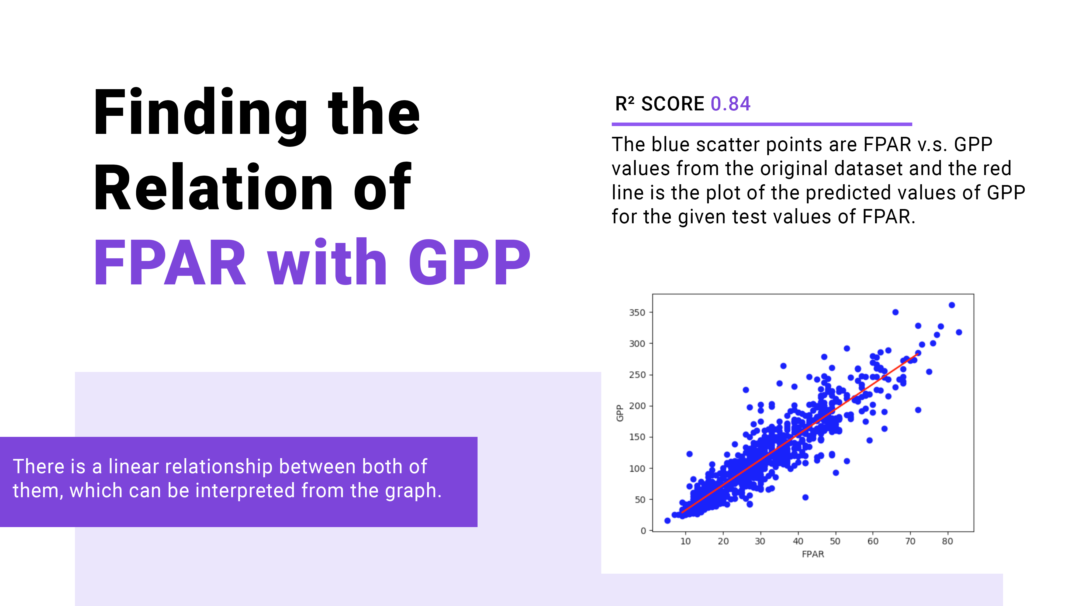

Slide 27


Slide 28


Slide 29
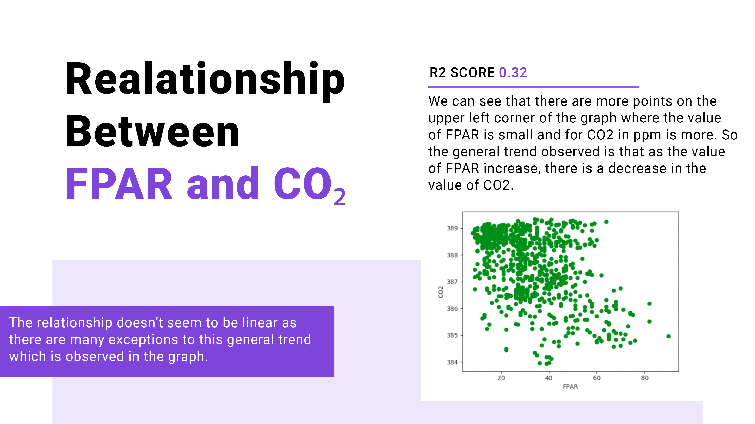
Relationship

Slide 30
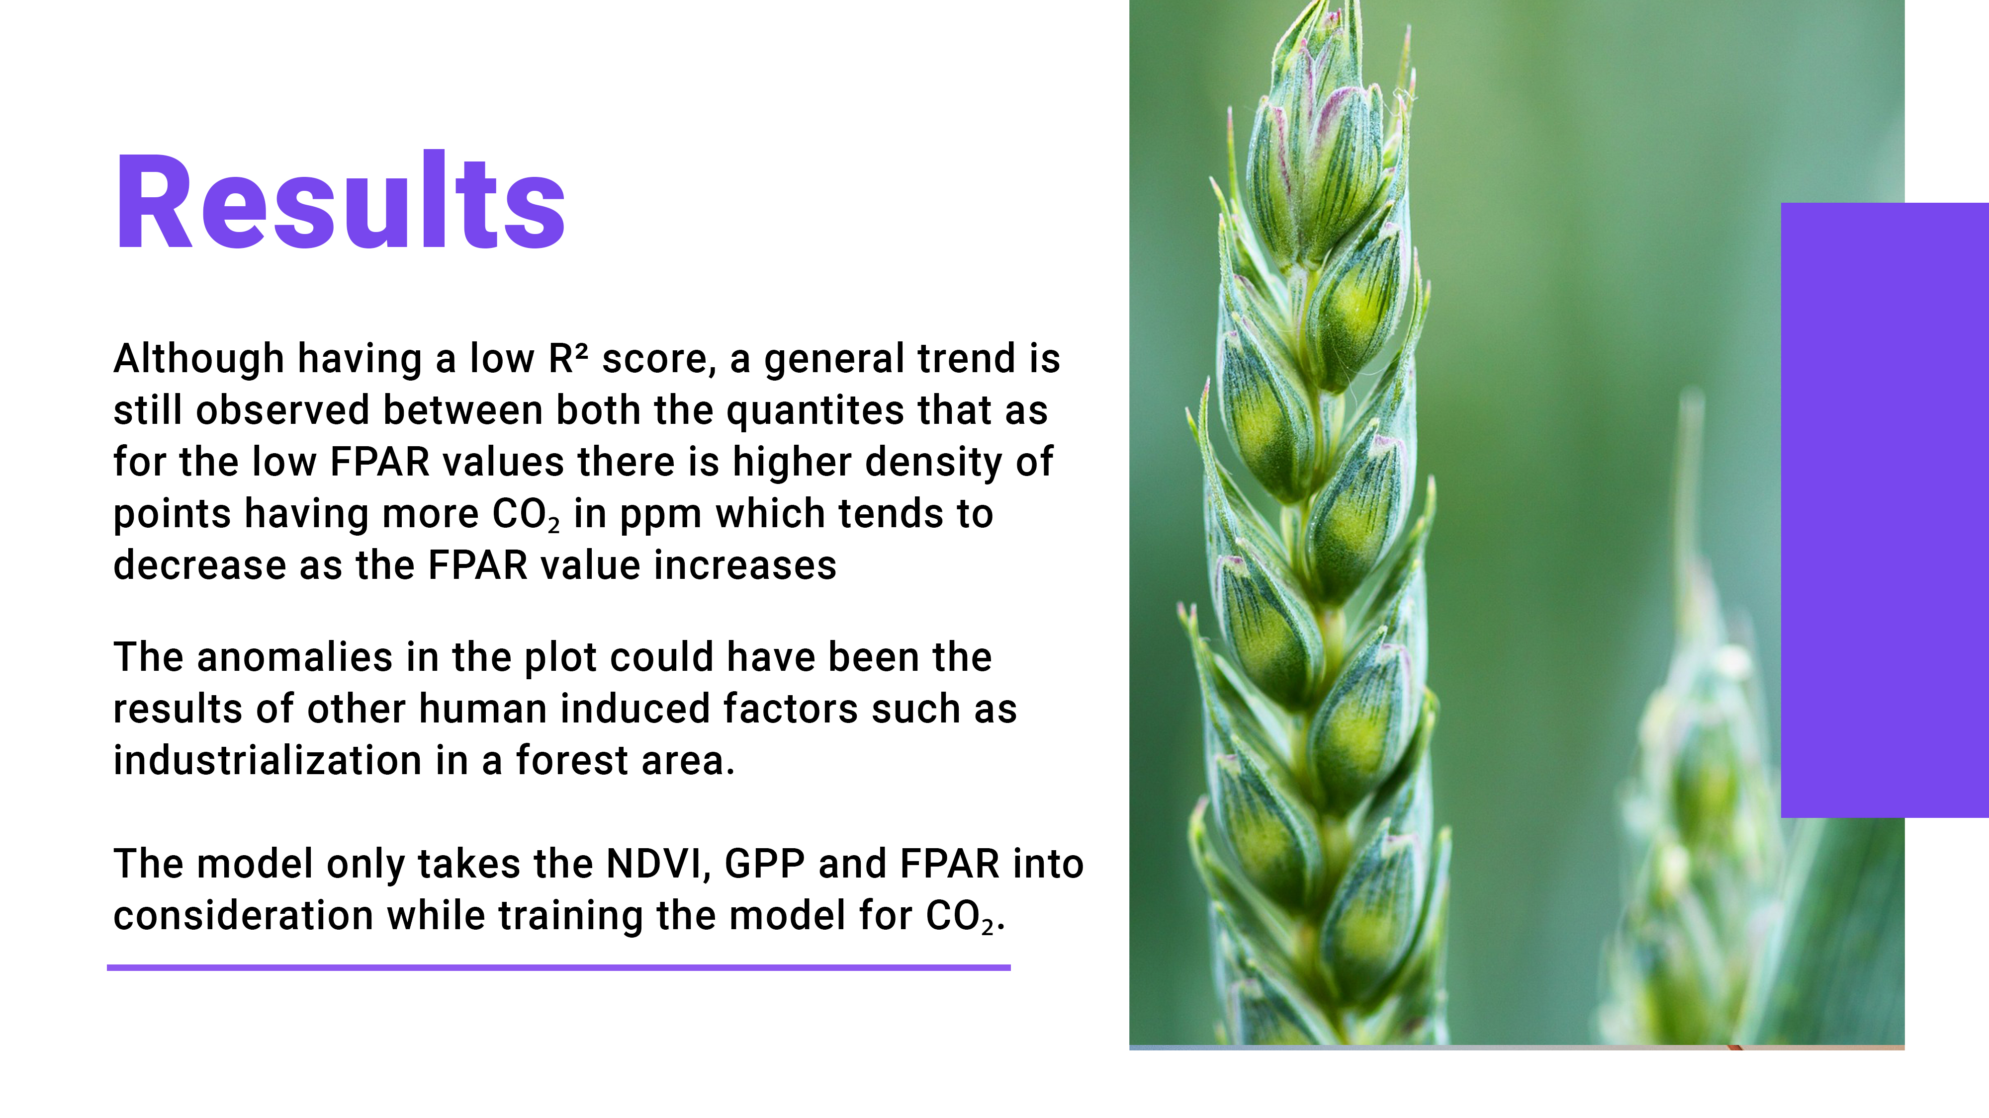

Slide 31
